Slide 1
Civil Discourse Map
Team Civil-Discourse
Luke Bonner, Amaka Ezuruonye, Hayden Garrett

Slide 2
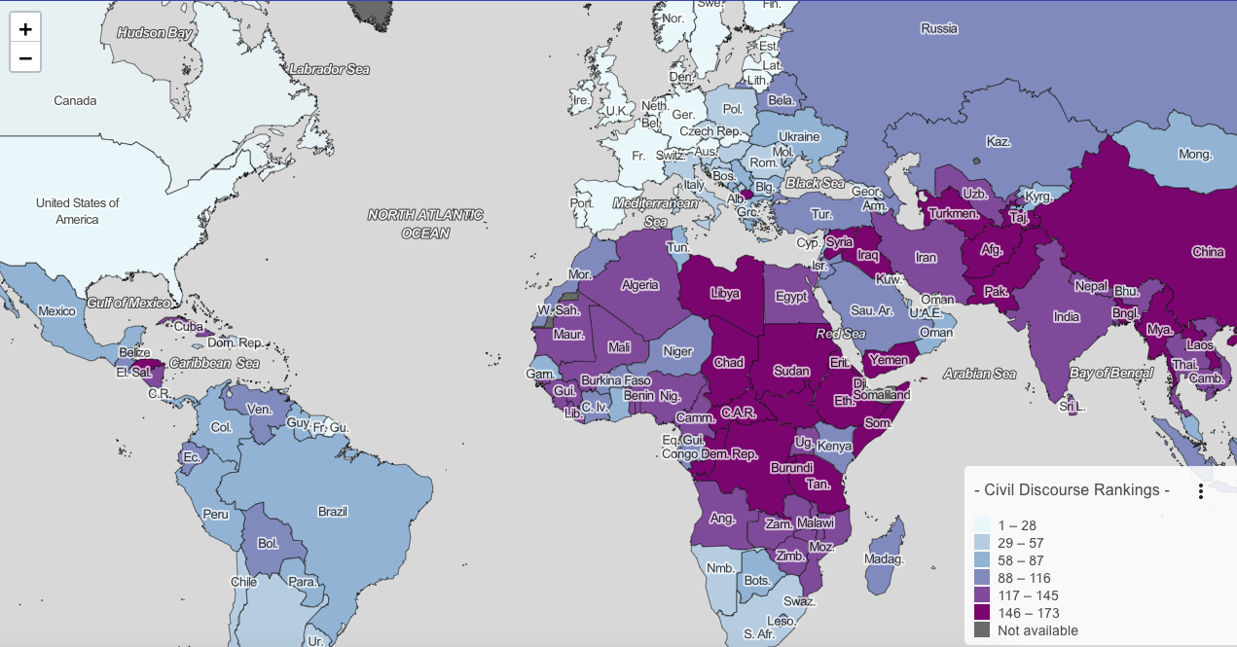
Goals
Add relevant headlines to English speaking countries
Enhance UI to give modern look and feel

Slide 3
Changes
Added multiple news sources to display relevant articles for each English speaking country
Switched color schemes to give neutral connotation to country discourse rankings
Changed layout of the country pages and ranking page to a modern look
Added documentation and guides that were missing
Deployed to live service (previously 2 teams work behind)

Slide 4
Future team goals and Global Disinformation Index (GDI)
Going into the future, upcoming teams will need to aim to implement:
Countries beyond English speaking countries
GDI journals (currently impossible due to Russian-Ukraine war)
AWS Lambda function streamlining > 75 country support
Split API call > 100 country support

